Slide 1

Physics 221:
General Physics II
Electricity, Magnetism, Optics and Modern Physics
Lecture 11: Magnetic interactions
Force on a moving charge
Examples: cyclotron, mass-spectrometer, auroras
Force on a current carrying wire
Diamagnetic, paramagnetic, ferromagnetic
Reading: 20.3-20.4, 20.7
Notes:
Demos:
Electron discharge tube – use magnet to deflect
Force on wire – use experiment with rolling bar in magnetic field

Slide 2

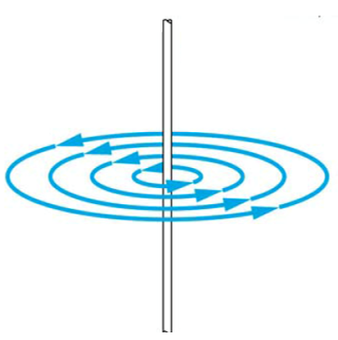
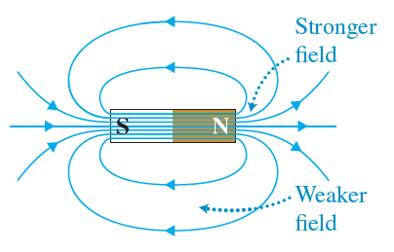

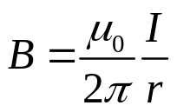
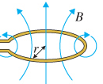
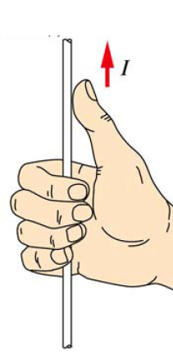
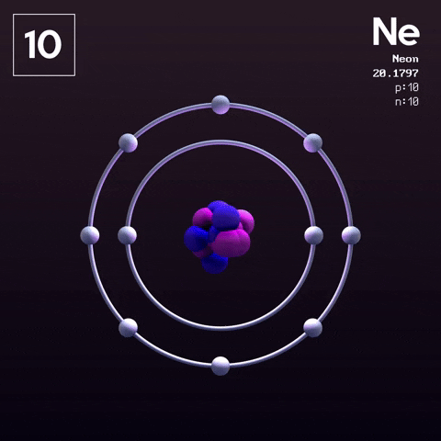

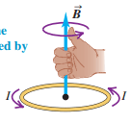
Magnetic field
Moving charges form a current, and electric currents create a magnetic field.
Permanent magnet: magnetic dipole
Current in a wire
r
Electron motion in atoms
Right hand rule

Slide 3
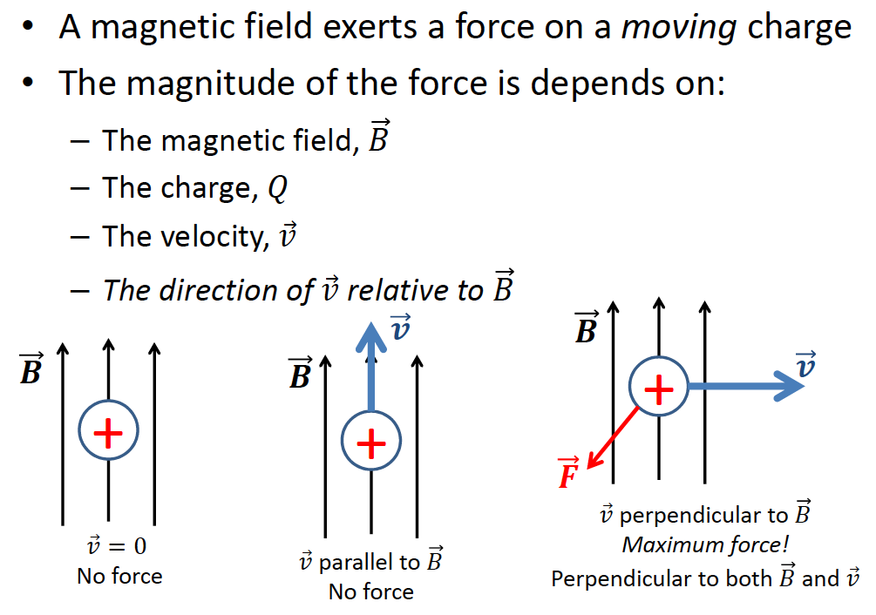
Magnetic force on moving charge
depends on:
Notes:
6B-02

Slide 4
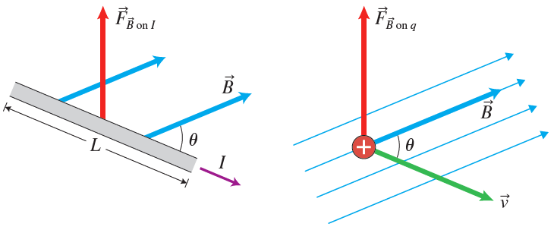
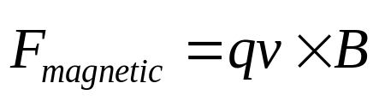


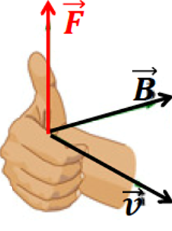


Magnetic force on moving charge
D
Magnetic force on a charge moving through magnetic field:
Cross-product!
q: sign of charge matters! Swapping sign to opposite
→swaps the direction of the force!
: velocity of charged particle
Right-hand rule for cross-product of two vectors
Fingers curl in the direction from to
Thumb shows the direction of the cross product
Note: this is the direction of magnetic force on positive charge
direction is opposite for negative charge
Note: force 1C charge moving at 1m/s in magnetic field 1T is 1N
Notes:
6B-02

Slide 5
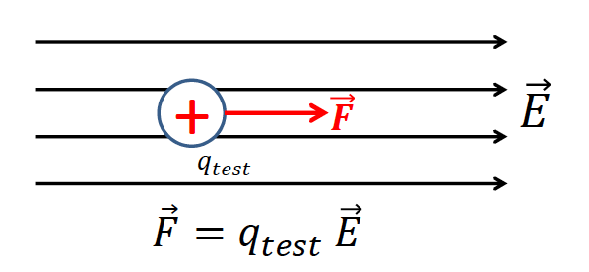
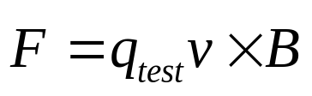
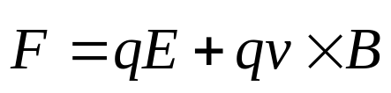
Comparison with Electric Field
Force in ELECTRIC field
(electrostatic force)
Force in MAGNETIC field
(magnetic force)
The force on a moving test charge is perpendicular to both magnetic field and direction of motion
The force on a test charge is in the same direction as the electric field
Combine both forces: electromagnetic force
Lorentz force.
Force on a particle moving through area with both electric and magnetic fields

Slide 6





Example
Q: A proton is moving through an area of constant magnetic field (into
page). What is the direction of the magnetic force on it?
А. Up ↑
B. Down ↓
C. Into the page
D. Out of the page
E. Left ←
F. Right →
Q: An electron is moving through an area with magnetic field.
What is the direction of the magnetic force on it?
Demo 6B-02

Slide 7


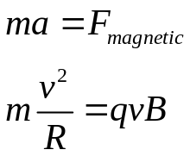
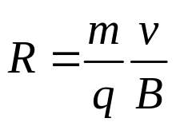
Motion in constant magnetic field
Q: What will happen to a moving electron that enters area with perpendicular magnetic field?
i) Speed will:
А. keep decreasing
B. Keep increasing
C. Will stay constant
-
ii) The force magnitude will
А. keep decreasing
B. keep increasing
C. will stay constant
iii) The force direction
А. will be constant
B. will keep changing
Trajectory: circle!
Find radius of circle:
iv) The kinetic energy
А. Will keep decreasing
B. will keep increasing
C. Will stay constant

Slide 8
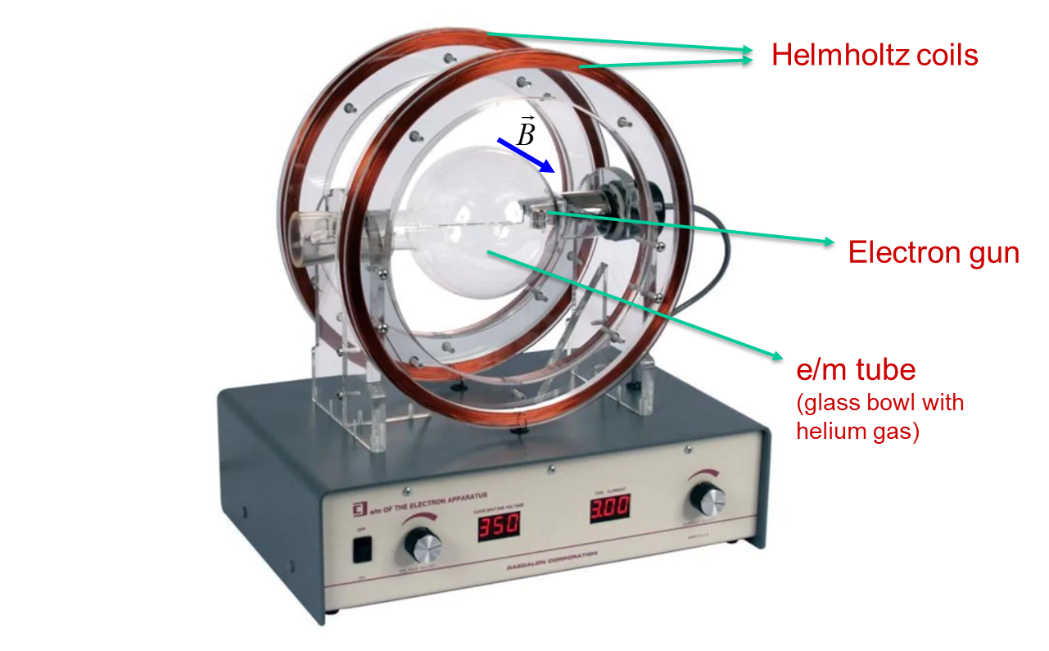
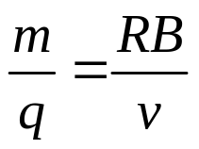
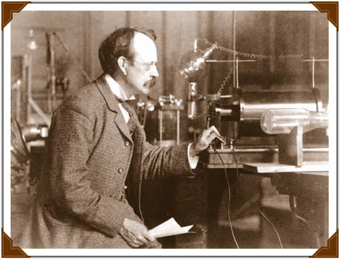
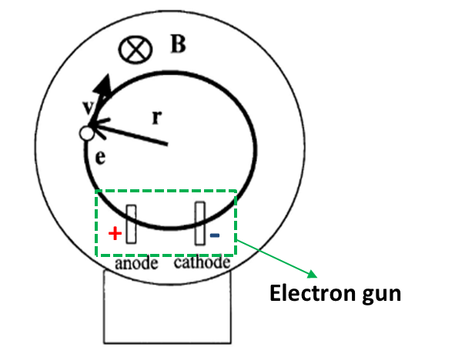
Example: electron, mass-to-charge ratio
Joseph John Thomson (1856-1940)
1897:
m/q more than 1000 times smaller
than hydrogen ion (the same q, much smaller m)!
Demo 6B-18

Slide 9
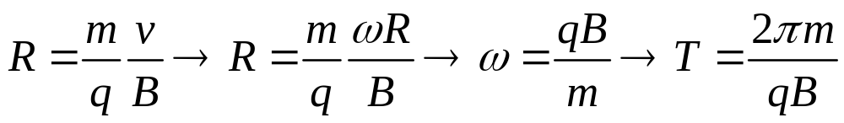
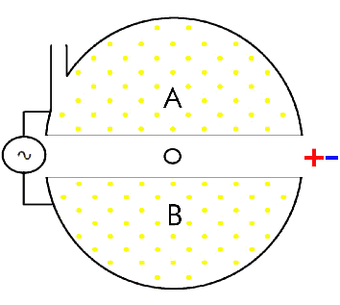
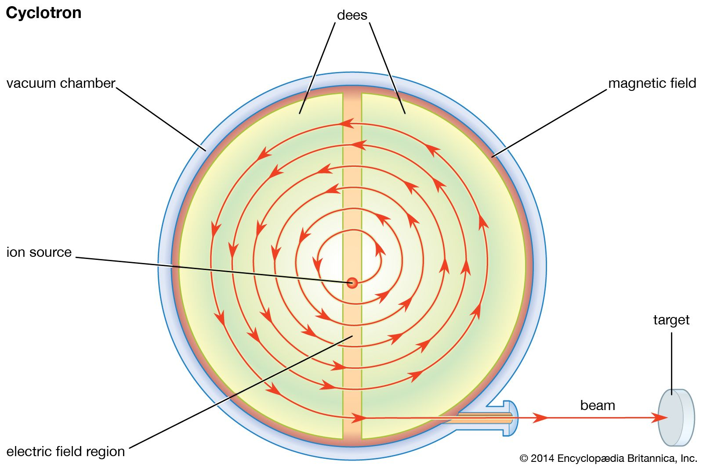
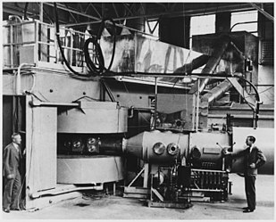
Example: cyclotron (cyclic particle accelerator)
R
Ernest Lawrence's 60-inch cyclotron, 1939

Slide 10
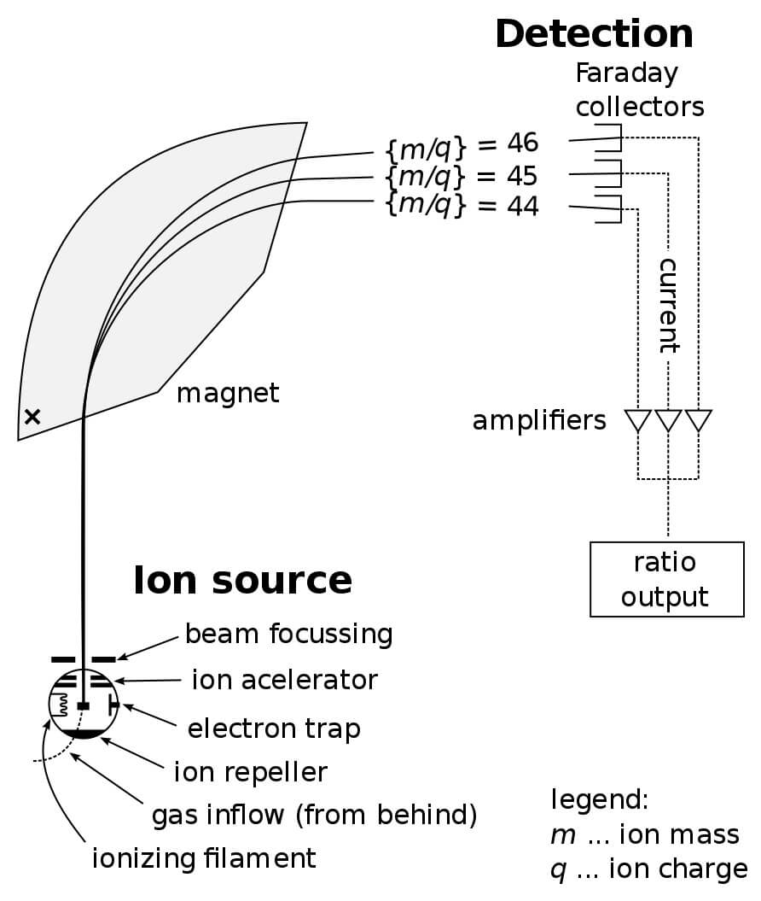
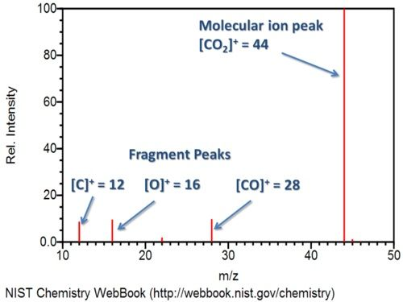
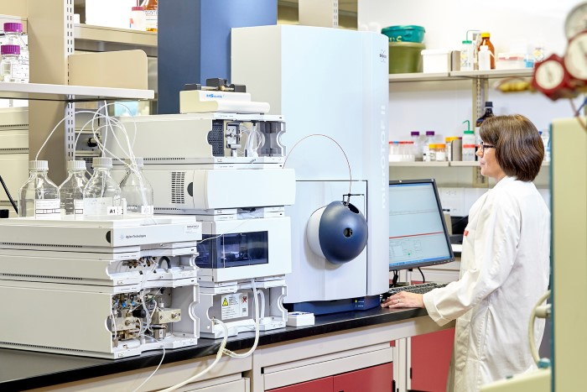
Example: mass-spectrometer→ To separate isotopes
deflection depends on mass to charge ratio m/q
https://biologydictionary.net/mass-spectrometry/
https://iidr.mcmaster.ca/cmcb/?page_id=78

Slide 11
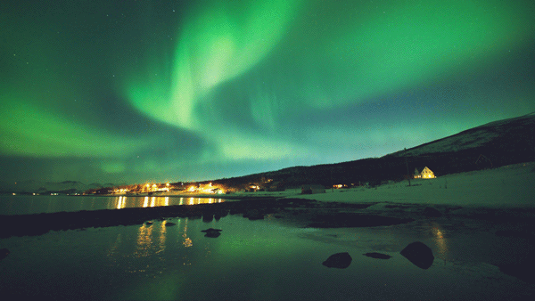
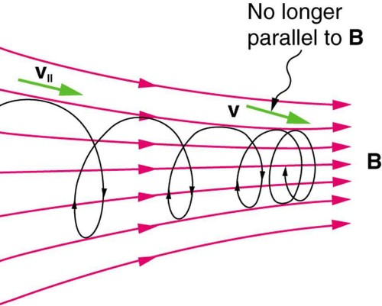
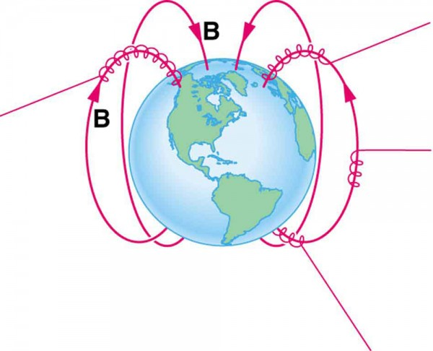

Example: auroras
Notes:
When a charged particle moves along a magnetic field line into a region where the field becomes stronger, the particle experiences a force that reduces the component of velocity parallel to the field. This force slows the motion along the field line and here reverses it, forming a “magnetic mirror.”

Slide 12

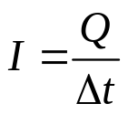

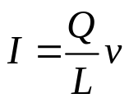
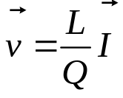
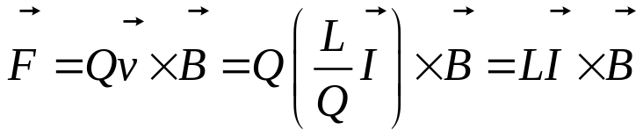

Force on a current carrying wire
Current: positive charges move in shown direction
Force on each charge:
Need to know:
total charge Q that is moving in the wire of length L
Velocity of each charge
Moving charges=current
Use definition of current:
Δt – time required for all charges to move out from the wire:
Combine last two equations:
Vector has direction of the current in the wire
Force on a current-carrying wire of length L:

Slide 13
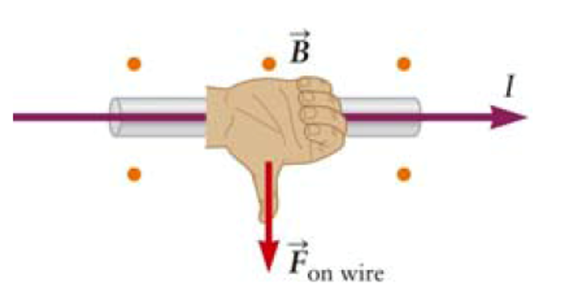

Force on a current carrying wire
Force on a current-carrying wire of length L:
Vector has direction of the current in the wire
Magnitude:
$$F=LIB\sin{θ}$$
Right-hand rule: point hand in the direction of current
bend fingers along magnetic field
thumb: direction of force

Slide 14
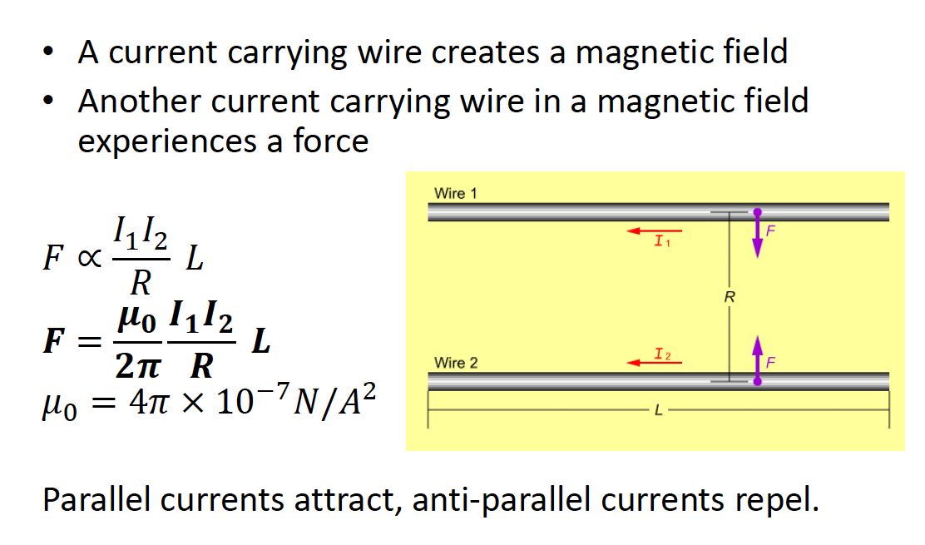
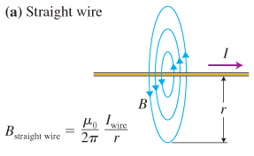
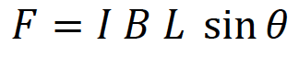


Force on Two Current Carrying Wires
D
$F=I_{1}B_{2}L\sin{90 }$= $I_{1}B_{2}L$
$F=$ $I_{1}B_{2}L=I_{1} \frac{μ_{0}}{2π} \frac{I_{2}}{R}L$
What about the direction of the forces between them?
Parallel currents attract, anti-parallel current repel. (Verify this!)
Notes:
6B-10

